Slide 1
Welcome to Information Technology Capstone.
The following topics will be covered in this lesson:

Slide 2
Topics
Scope Of the Project
Control Measures
The Goals and Objectives
Detailed, realistically estimated cost analysis of the entire project
Competitive advantages IT will afford the Organization
All IT Implementation into the project plan
Bibliography

Slide 3
Scope Of the Project
The scope of this project includes several areas. For each area, there should be a corresponding strategy for incorporating these areas into the overall project.

Slide 4
Continued
Applications. Sites. These sites are considered part of the implementation: therefore, skilled IT individual needs to be employed to build the best website which is highly optimized on the search engineer of the google
Process Re-engineering. Re-engineering will be done to help the company rethink how we do our work to improve our customer service.
Customization. Customizations will be limited to those people in the third world countries because of less bandwidth.
Interfaces. The interfaces included are: the user interface which would be simplified with an application for the mobile users and a well-designed graphical user interface for desktop computers
Architecture. Application and Technical Architecture will be updated and improved on to keep up with the technology.

Slide 5
Continued
Testing. It will include only the traffic on the site which is important for the easy form of the buying process of the books and other transactions
Funding. Project funding is limited to the expansion of the foreign infrastructure
Training. Training will be conducted on all the employees of the company.
Education. It will include those in the management, IT department, customer services and quality assurance.
Conversion. Only the following data and volume will be considered for conversion:

Slide 6
Continue
In order to meet the target production date, only these applications will be implemented: The mobile application for the company, the Inventory System and the Rational Databases System.
We would be integrated the different databases,
Maximum security is going to be taken serous because we will be dealing with huge data from all over the world.

Slide 7
Control Measures
Doing such a huge project like our company which is locally and international, requires careful planning as well as money and time.
The project controls method are needed by the use of cloud-based project management software.
The project management software would be necessary for this project to be efficient.

Slide 8
The Goals and Objectives
Its goal is to make our company to be the world number one distributor of books.
To grow by two hundred thousand employees with a revenue of $2 billon over the next ten years.
To update our window operating system to the current one to meet our need for the software upgrade.

Slide 9
Objectives
Executing the above project will give our customers, a well reliable company to buy books from and our employees, a secured company to work for.
Use mobile technology like the Mobile Self-Service applications enable smartphone, tablet, and other smart devices.
Build a responsive web design for this task which will make it easy for the customer to navigate the site.

Slide 10
Detailed, realistically estimated cost analysis of the entire project
Project Budget
The whole project would cost the company an estimate of $ 300 000.
All these Investments would be returned in the next five years.
The profits made in those countries by matching every dollar earn to ten cents invest on building new structure.
All the funds for the whole project is going to be summarized below.

Slide 11
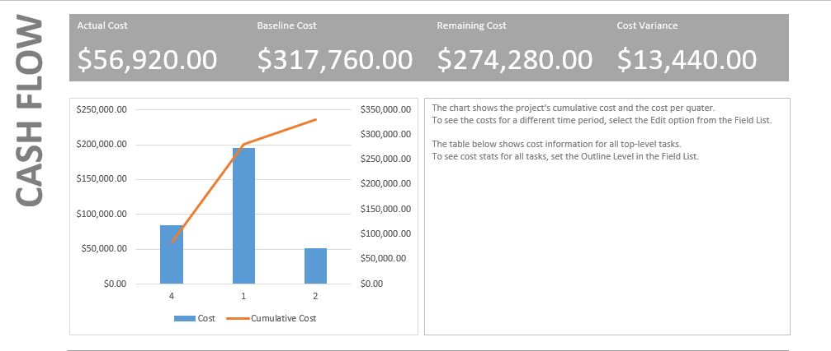
Cash Flow Report
The above report summary the cash flow of the whole project which can be see as shown above.

Slide 12
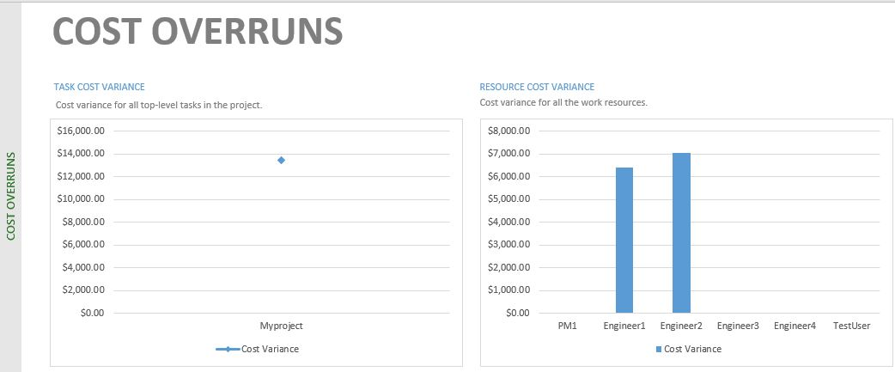
Cost Overruns Report
The above figure shows the cost overruns of the project which is simplified with the bar chart on the right.

Slide 13
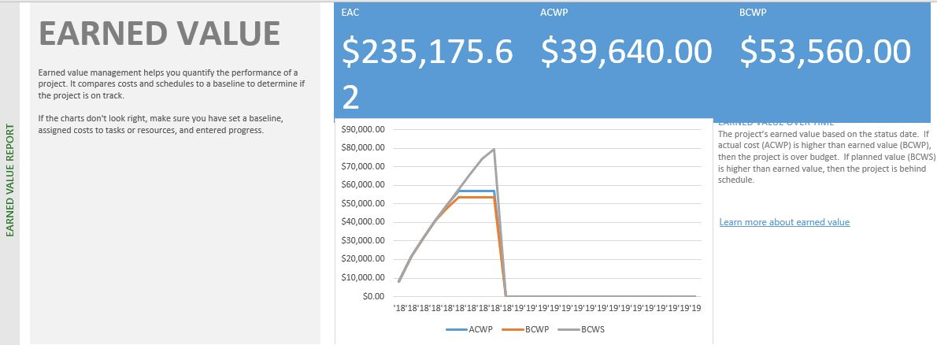
Earned Value Report
The earned value figures are shown above with the amounts in blue on the right top corner of the figure.

Slide 14
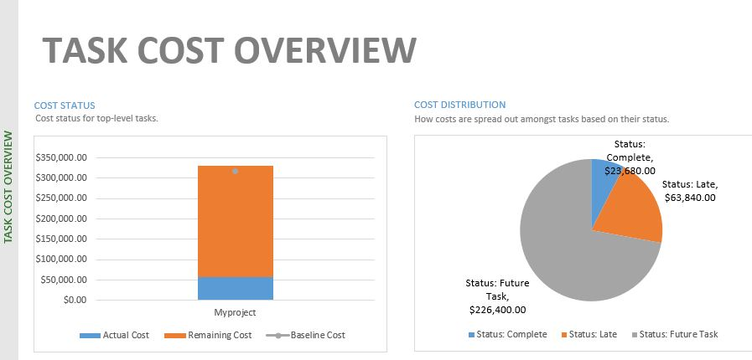
Task Cost Overview
The above figure shows the Tasks cost overview of the project which is in form of a pie chart on the right of the figure.

Slide 15
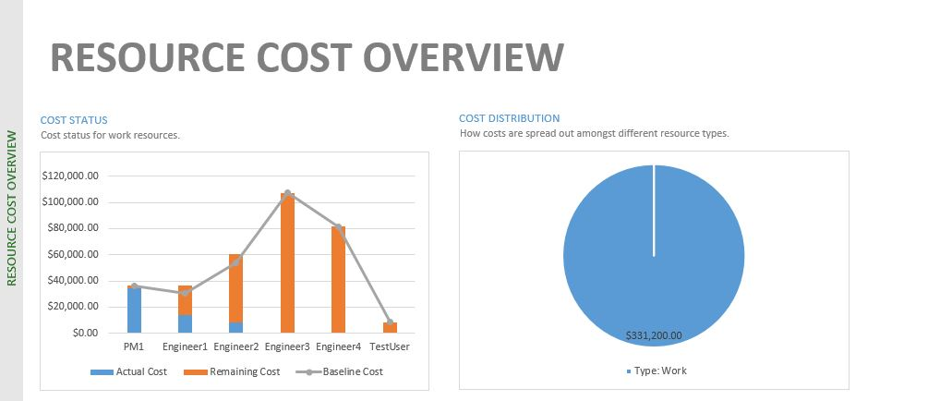
Resource Report
The above shown figure summarized the resources of the projects and the amount each will cost as can be seen.

Slide 16
Competitive Advantages IT Will Afford the Organization
The company would provide and maintain a quick way of selling books online world wide,
It will attract users and buyers as well as employees who want to work for an ecommerce company.
The company would keep up with these technology by give our customers an easy platform of buying books online;
IT department would make sure the site is available at all time using the method of business continuity during the time of a disaster.
All these changes will would be made in an unobtrusive, cost-effective manner.

Slide 17
All IT Implementation into the project plan
The Implementation is the process of putting our decision or plan into execution.
Our company’s needs.
Higher Level Design
Details Design.
System Configuration
System Implementation
System Maintenance.

Slide 18
Bibliography
(Kerzner i) Kerzner, Harold R. Project Management - Best Practices: Achieving Global Excellence, 3rd Edition. John Wiley & Sons P&T, 01/2014.
Roberts, D. (2013). Unleashing the power of IT. (2nd ed.). Hoboken, NJ: John Wiley & Sons, Inc.
http://www.ambysoft.com/unifiedprocess/aup11/html/inception.html
http://support.sas.com/resources/papers/proceedings17/SAS0436-2017.pdf
https://econsultancy.com/reports/building-an-ecommerce-team/

Slide 19
Continued
https://searchnetworking.techtarget.com/answer/Why-is-it-useful-to-use-both-a-physical-and-a-logical-network-design
https://www.wipo.int/edocs/mdocs/scit/en/scit_4/scit_4_2-annex2.pdf
https://implementationscience.biomedcentral.com/articles/10.1186/1748-5908-9-43

Slide 20
Summary
Scope Of the Project
Control Measures
The Goals and Objectives
Detailed, realistically estimated cost analysis of the entire project
Competitive advantages IT will afford the Organization
All IT Implementation into the project plan
Bibliography

